Slide 1
NE 795: Advanced Reactor Materials
Fall 2023
Dr. Benjamin Beeler

Slide 2
Housekeeping
Last exam on Thursday
Complete the class eval poll
Complete my poll also for a +5 on exam:
https://docs.google.com/forms/d/1t09SuKXjy14ONllMwl9JbGAfjAnQe30bZCRzleXsFJI/edit
Will send this out to everyone after class

Slide 3
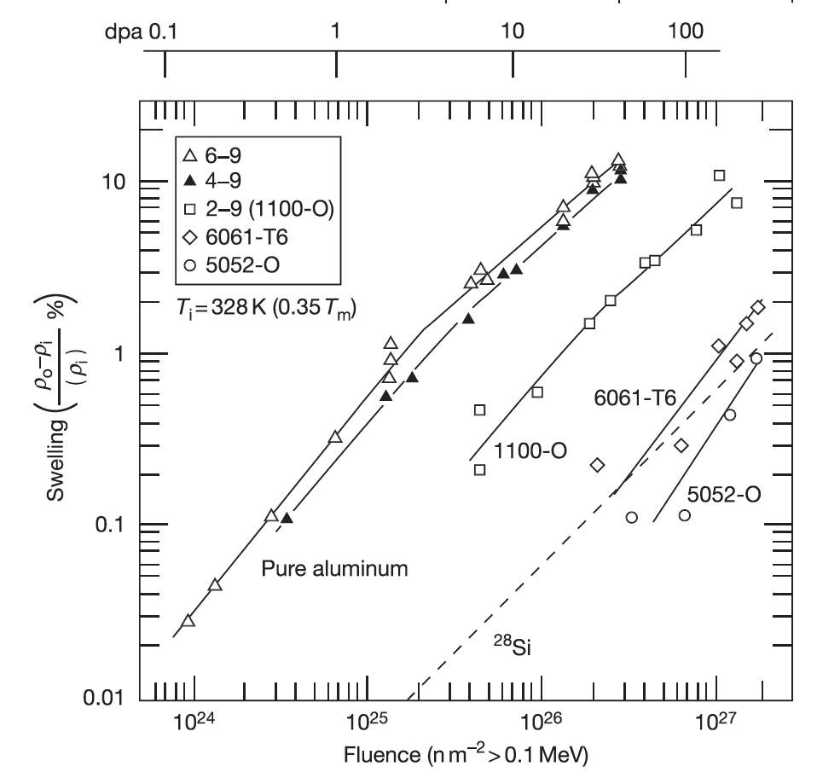
Swelling
Swelling is due to the accumulation of voids from excess vacancies
Gas bubble swelling is generally not an issue for Al in RRs because the temperature is too low
The 6061 alloy, with its inherent Mg2Si phase, starts swelling appreciatively later in dose than the 1100-O or pure Al
Swelling is limited to less than 1% for the higher levels of fluence expected in RRs

Slide 4
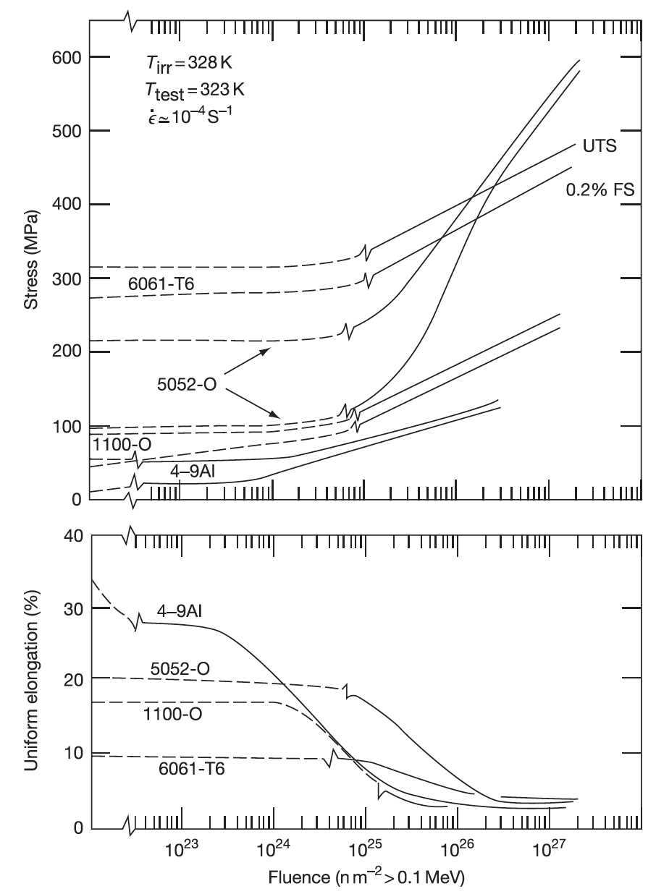
Hardening
The major consequences of radiation damage structures on the mechanical properties of Al alloys are radiation hardening and associated loss in ductility
Al6061 is generally a stronger alloy than comparable Al alloys
Hardening and reduction in elongation occur at approximately 1E25 n/m2, with as much as a 2X (1/2X) effect on the associated property

Slide 5
Summary
The Zr interdiffusion barrier prevents U-Mo-Al interaction, but creates new interaction layers with a series of phases present
U-Mo fuel creeps, creating a bulge just inside the edge of the fuel
Decomposed regions can accelerate grain refinement and swelling and can be reduced through chemical homogenization and annealing
Fuel fabrication specifications can dramatically affect the microstructure and thus the performance of the fuel – this is more critical for monolithic fuels
Microstructural modeling is attempting to describe the variety of governing phenomena in U-Mo fuel
Al is ideally suited for the research reactor environment with its excellent corrosion and swelling resistance at applicable temperatures

Slide 6
Reactor Operating Range

Slide 7
Fuel Assemblies

Slide 8
RTR Cores

Slide 9
supercritical water cooled reactors

Slide 10
Supercritical Water Reactor (SCWR)
Similar to a traditional light water reactor, but operates at a supercritical pressure
Water heated in the core becomes a supercritical fluid, which can directly be used in a steam turbine
Removes the added step of a heat exchanger, increasing the efficiency of the reactor system

Slide 11
Supercritical water
A supercritical fluid is a substance with a temperature and pressure above its critical point
At such a point, distinct solid and liquid phases do not exist
Critical point of water is 22 MPa and 647 K
Density is highly variable, based on temperature and pressure:
0.78 g/cc @ 25 MPa and 280 C
0.09 g/cc @ 25 MPa and 500 C
these are reasonable inlet/outlet temperatures for SCWR coolant

Slide 12
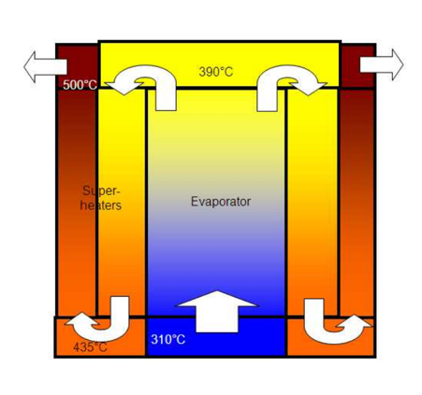
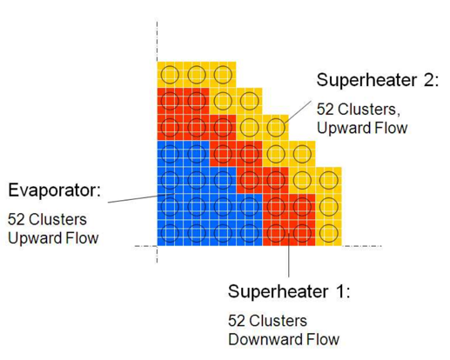
Comparison to LWR
SCWR
coolant in: 280 C
coolant out: 600 C
outlet specific enthalpy: 3150 kJ/kg
three pass coolant
coolant pressure: 25 MPa
LWR
coolant in: 275 C
coolant out: 315 C
outlet specific enthalpy: 200 kJ/kg
one pass coolant
coolant pressure: 15 MPa

Slide 13
Features
Supercritical water has excellent heat transfer properties allowing a high power density, a small core, and a small containment structure
The use of a supercritical Rankine cycle with its typically higher temperatures improves efficiency (would be ~45 % versus ~33 % of current PWR/BWRs)
This higher efficiency would lead to better fuel economy and a lighter fuel load, lessening residual (decay) heat
SCWR is typically designed as a direct-cycle, whereby steam or hot supercritical water from the core is used directly in a steam turbine with no intermediate heat exchangers, etc
SCWRs can operate as a fast breeder, or utilize heavy water and the thorium fuel cycle
Disadvantages include operating at very high temperatures and pressures, increasing material challenges
The economic advantage of a direct cycle is a downside with regard to safety, in that a cladding breach means your turbine and generators are directly exposed to radioactivity
Corrosion in SCW is a challenge

Slide 14
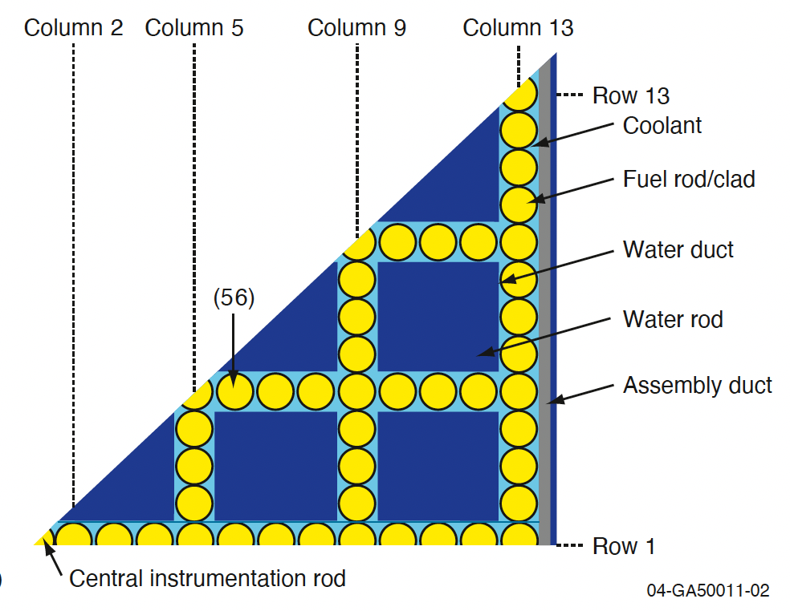
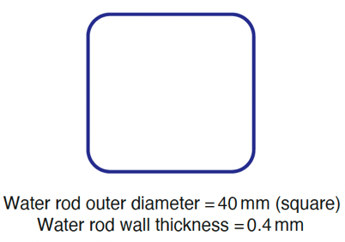
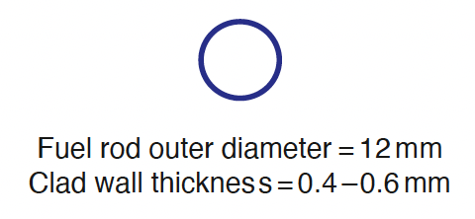
SCW geometry
There is experience in SCW cycles in the fossil fuel industry, however they are able to use thick-walled geometries that are not feasible in nuclear designs
1/8 assembly model SCWR core

Slide 15
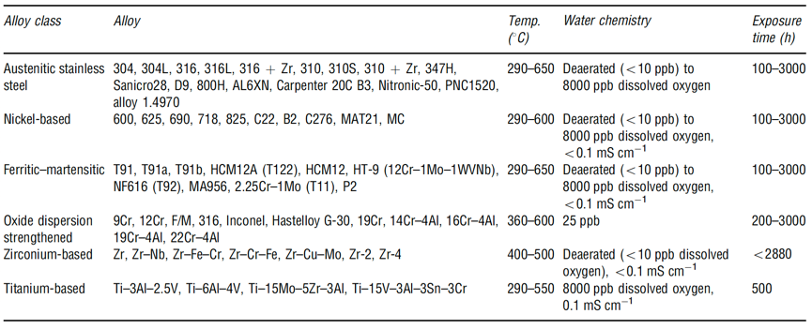
Corrosion
These very thin-walled components provide little margin for corrosion in an SCWR core, where the consequences of failure are significant
Oxide films and deposition of corrosion products from out-of-core components can lead to overheating (and failure) and changes in reactivity
SCW corrosion studies have included F/M steels, austenitic steels, Ni alloys, Zr alloys and Ti alloys

Slide 16
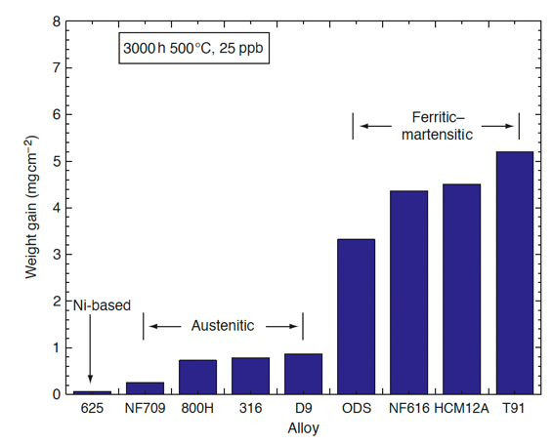
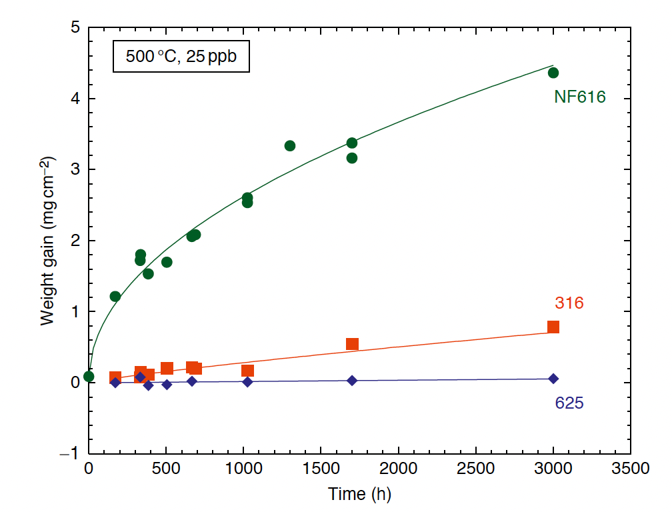
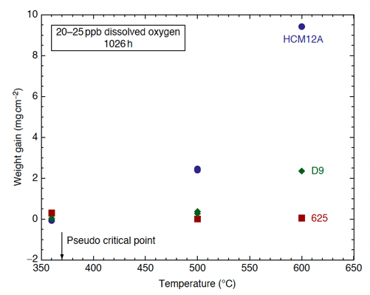
Alloy Classes
Corrosion is strongly dependent upon the alloy class
Oxidation is most rapid for F/M steels and slowest for Ni alloys
Temperature has a very strong effect on corrosion
Dissolved O content 25 ppb
NF616 = F/M
316 = aust.
625 = Ni
HCM12A = F/M
D9 = aust.
625 = Ni

Slide 17
Stress Corrosion Cracking
Austenitic stainless steels and nickel-based alloys exhibit susceptibility to IGSCC in pure SCW over the temperature range of 400–650C
IGSCC decreases with temperature, but overall fracture increases with temperature
Small additions of HCl or H2SO4 increase susceptibility to IGSCC in austenitic alloys
Ni based alloys are more susceptible to SCC than austenitic steels
Higher Cr content in Ni alloys seems to reduce the extent of SCC
F/M alloys are generally resistant to SCC (HT-9 is an exception)
Irradiation strongly exacerbates SCC, but the effect decreases with increasing temperature

Slide 18
CO2 corrosion in reactors

Slide 19
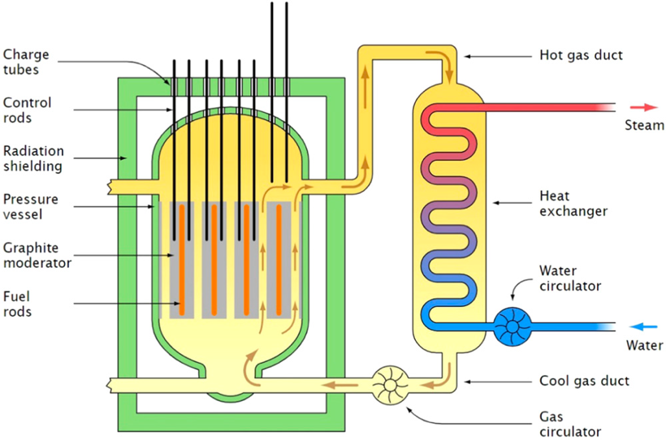
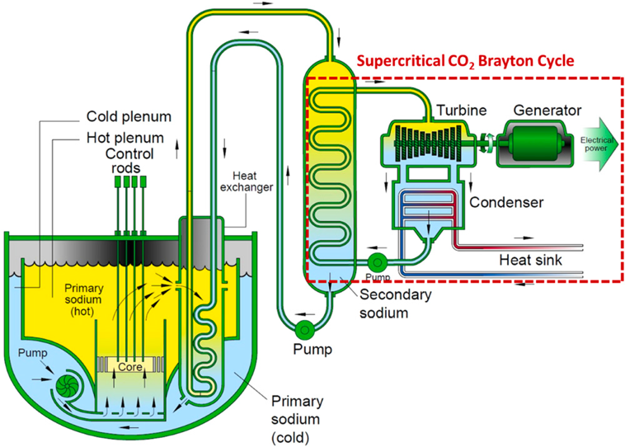
CO2 Applications
Magnox CO2-cooled reactor
Tertiary cycle with supercritical CO2

Slide 20
CO2 Usage
Remove concerns for interaction of liquid metal coolants with water/steam while achieving similar efficiencies
CO2 can serve as primary coolant in gas cooled reactor systems
Fe-Cr steels are considered as the primary structural components in contact with CO2 gas
Corrosion resistance is of primary concern, especially for parts at high temperatures and with expected long lifetimes
Unlike conditions encountered in SCWRs, corrosion in pure sCO2 is not electrochemical in nature but is instead characteristic of a gas-phase oxidation process

Slide 21
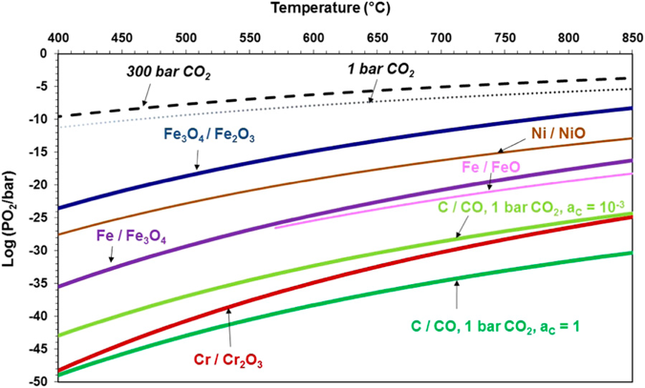

CO2 Corrosion
Exposure of structural alloys to CO2 results in the formation of a metal oxide layer on the surface
Oxidation comes from partial pressure of oxygen in the CO2 decomposition reaction:
Even at very low oxygen PP, metal oxides will still want to form
Typically, steady-state parabolic growth kinetics are achieved, with the rate-limiting step of diffusion through the oxide layer

Slide 22
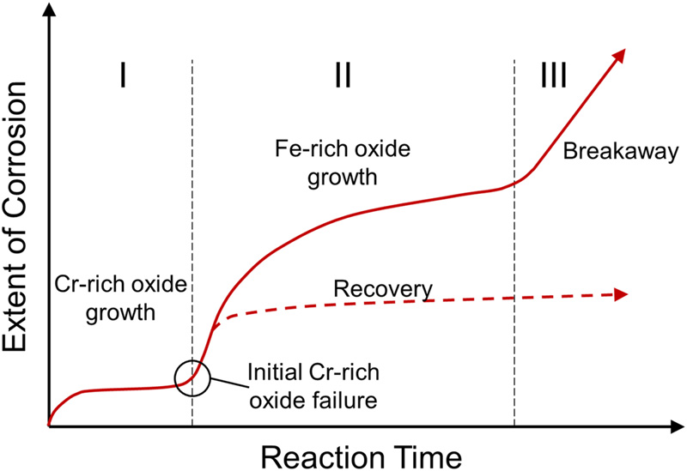
Three-regime corrosion
For steels with enough Cr, a thin Cr-rich oxide scale forms during the early stages of exposure
If the steel does not contain enough Cr or if the previously formed Cr-rich oxide scale growth is disrupted, an Fe-rich oxide scale is formed
The growth rate of Fe-rich oxides is significantly faster than Cr-rich oxides, leading to higher oxidation rates
Third regime is linear kinetics and labeled breakaway swelling

Slide 23
Composite fuels

Slide 24
Composite Fuels
Composite fuels consist of a fissile phase dispersed in an inert, nonfuel matrix
These types of fuels have been used since the 1950s in high-temperature and high-power density applications
Composite fuels are typically distinguished into two types: Cermet and Cercer
Cermet: ceramic fuel particles dispersed in a metallic matrix
Cercer: ceramic fuel particles in a ceramic matrix
47 different fuel matrix combinations have been experimentally explored
Composite fuels have potential as high burnup fuels to either transmute transuranic elements, or to replace conventional UO2 fuel pellets

Slide 25
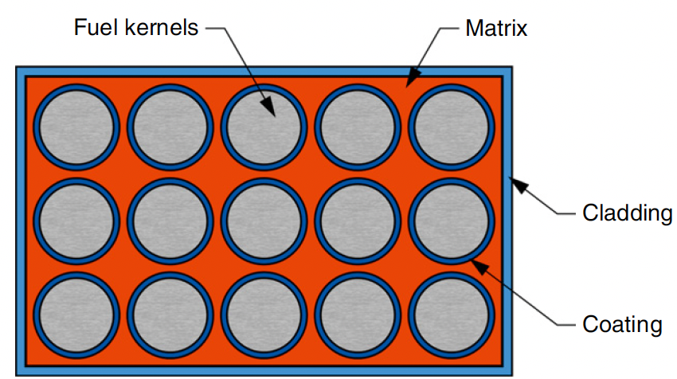
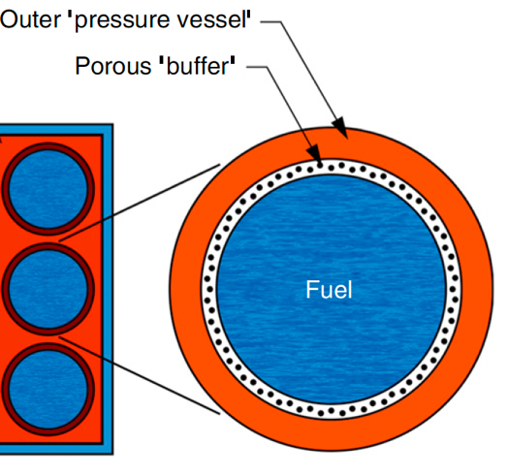
Composite Fuels
The most complete experimental work focused on UO2 particles dispersed in stainless steel
The primary feature that distinguishes composite fuels from the pellet-in-cladding fuel types is the localization of fuel material within an inert matrix
Fuel particles can be individually clad within the matrix material by an individual coating

Slide 26
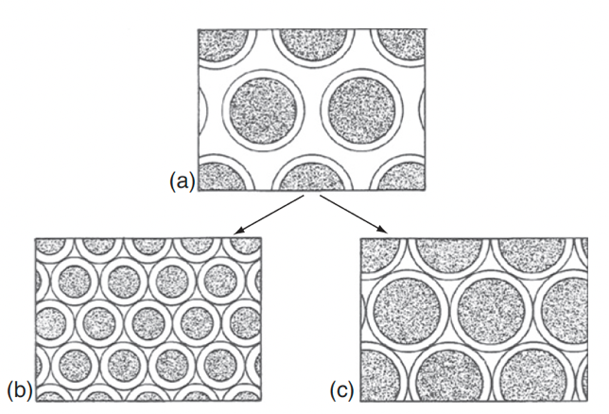
Cermet Fuel
The performance of the Cermet fuel depends on the ability of the matrix to retain strength and ductility during irradiation
The strength of the matrix must be sufficient to resist cracking from stresses due to solid fission products and fission gas swelling
The major source of matrix degradation is the fission fragments ejected from the fuel
The distance between (or density) of fuel particles must be sufficient such that the damage region around a given particle does not overlap with an adjacent particle

Slide 27
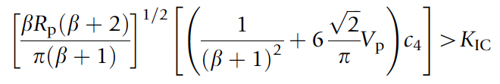
Cercer Fuel
The typical failure mode in cercer fuels is fuel particle swelling that leads to a tensile stress in the matrix, followed by matrix cracking
Models have been constructed to predict failure taken from thermal expansion in duplex ceramics
Increasing the interparticle distance, decreasing the particle size, decreasing fuel swelling and thermal expansion, etc., reduce the probability of fracture of the matrix

Slide 28
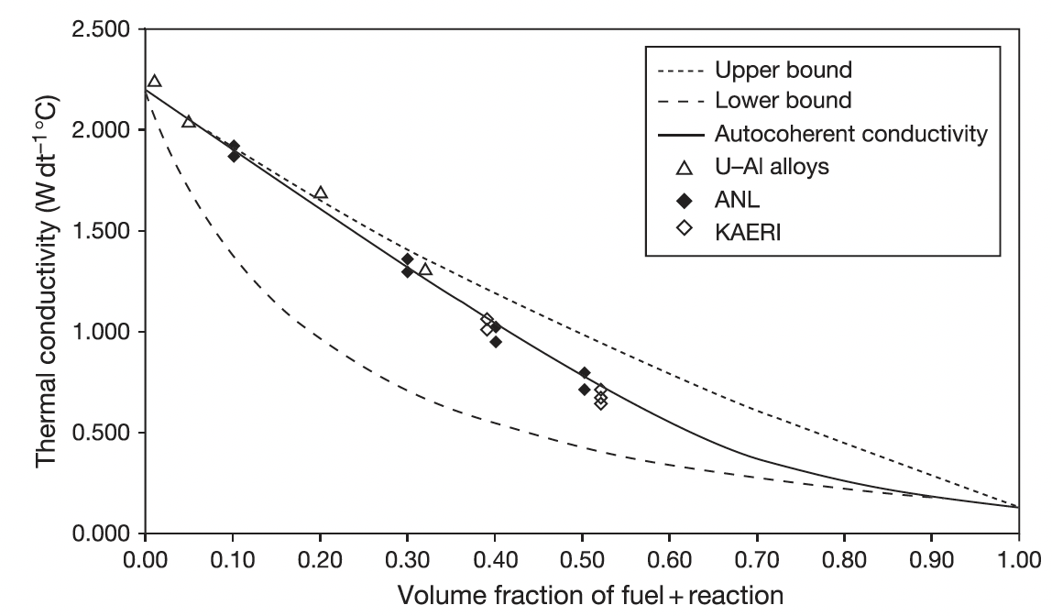
Composite Thermal Conductivity
The behavior of composite fuels can be heavily influenced by fuel operating temperature, and thermal conductivity is of primary importance in the irradiation behavior of these fuels
Fuel particle size, shape, orientation, and distribution, and matrix porosity and the thermal conductivities of the fuel and matrix species are the key properties of interest

Slide 29
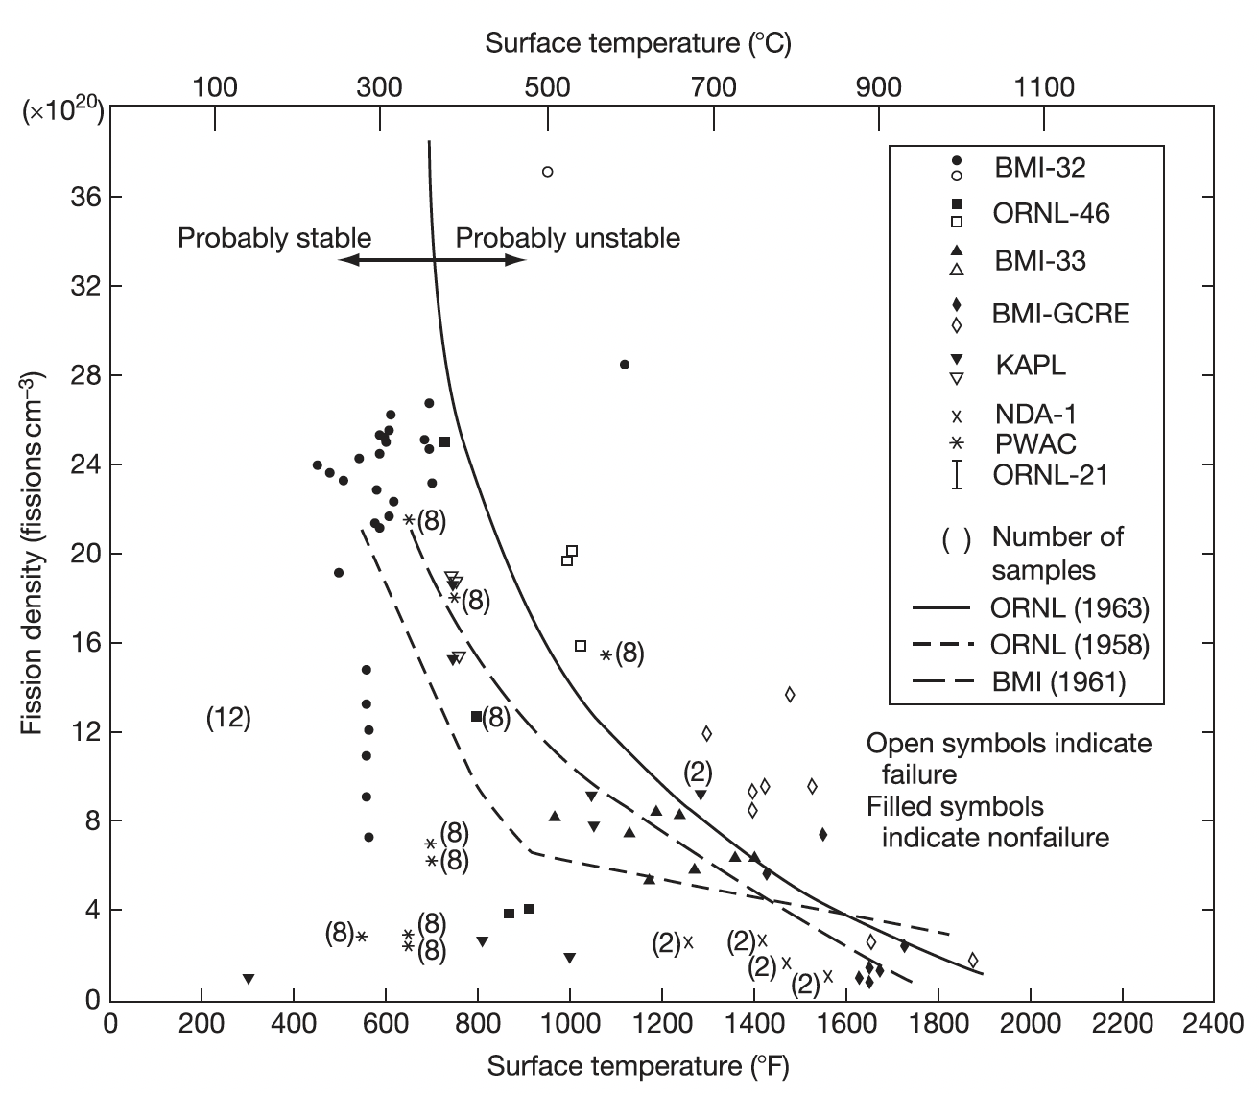
Irradiation Behavior
Most irradiation information is on UO2 dispersed in stainless steel
Full-size 20vol% plate-type elements reached 65 at% burnup at surface temperatures of 315–427C with no blistering or cracking
There are bounding limits on fission density (+ loading) and surface temperature
Higher matrix loadings are possible, but are restricted to low (<15%) burnups

Slide 30
Particle fuels

Slide 31
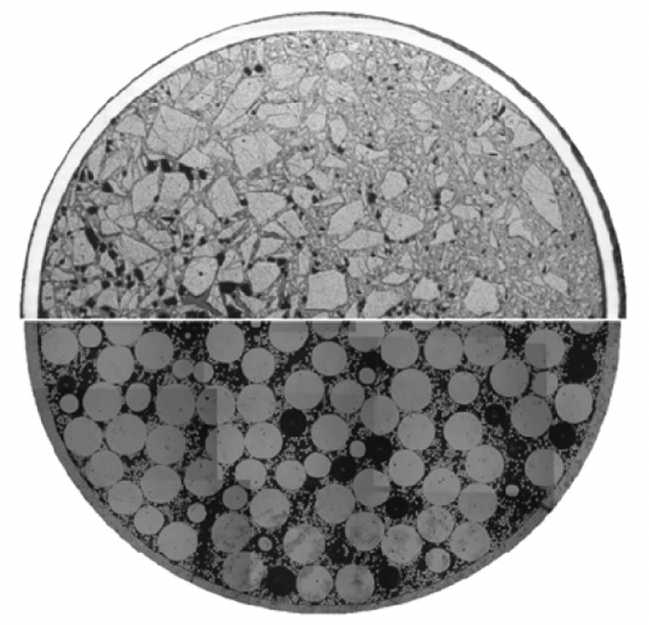
Particle Fuels
Vipac
When the fissile isotopes are coming from spent fuel that is chemically separated (reprocessed), particle fuel with its direct filling of fuel particles into the fuel pin offers several advantages
Two major types of particle fuel are sphere-pac and Vipac
sphere-pac

Slide 32
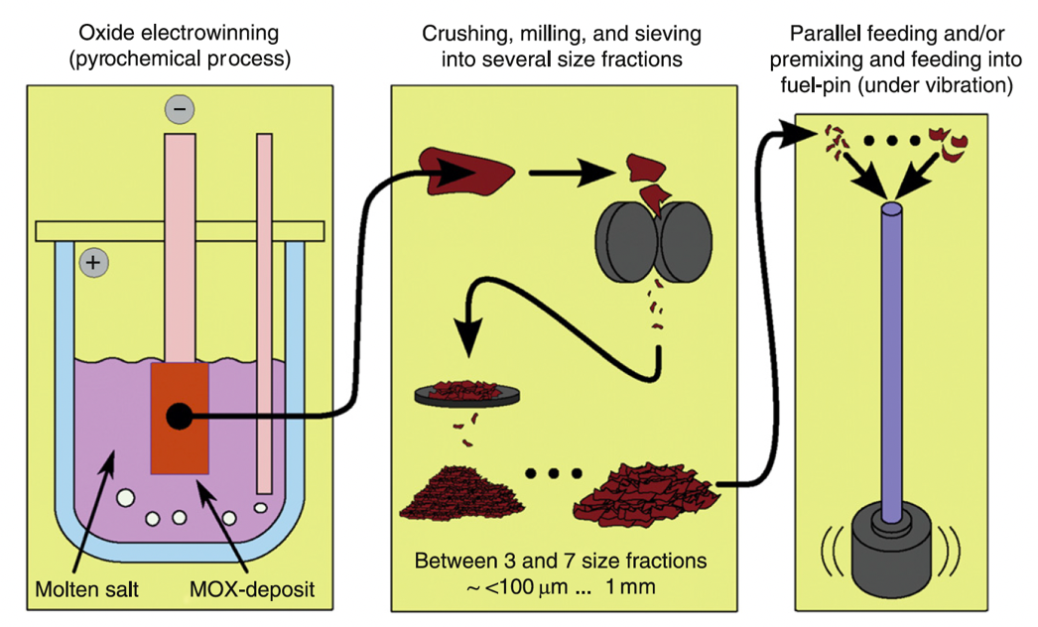
Vipac
The usage of randomly shaped (angular shards) particles as nuclear fuel component filled in a cladding goes back to the 1950s
Reprocessing of fuel from the BOR-60 reactor was pursued to developed fuel for the BN-600 reactor – MOX fueled fast reactors
These particles are fed into the cladding under vibration
Vibration packing = Vipac

Slide 33
Sphere-Pac
Sphere-pac fuel is also composed of particles which are directly filled into a fuel pin
However, particles are shaped into spheres to generate a more predictable arrangement of particles in the fuel pin
Sphere-pac is used in conjunction with the PUREX process, combined with follow-up processes such as actinide extraction
A fully aqueous method offers excellent distribution of the fissile material in the matrix and the formation of solid solution in the ceramic
This also eliminates the need for mechanical devices, reduces powder generation, and thus minimizes contamination

Slide 34
Particle Fuels
This modified geometry of fuel will present important changes in the fuel properties as a unit
The thermal conductivity is reduced, which increases the centerline temperature, and can lead to restructuring
The fuel is softer because of the void space, reducing FCMI
Significantly higher fission gas release, due to the prevalence of free surfaces
In the case of a cladding breach, this increased fuel surface area provides greater opportunity for coolant reaction with the fuel
At fuel startup, fuel particles are not bonded, and in case of early life cladding breach, potential loss of fuel particles

Slide 35
Macrostructure Changes
The macrostructure of the fuel changes with operation
The high temperature will lead to sintering and restructuring into different zones (as in MOX fuel)
Similar four zone restructuring will occur, but with different zones
1: central void; 2: highly dense fuel similar to a pellet; 3: sintered microstructure with retained porosity; 4: original particle macrostructure
As the structure of the fuel changes, the properties change dramatically with radius and time

Slide 36
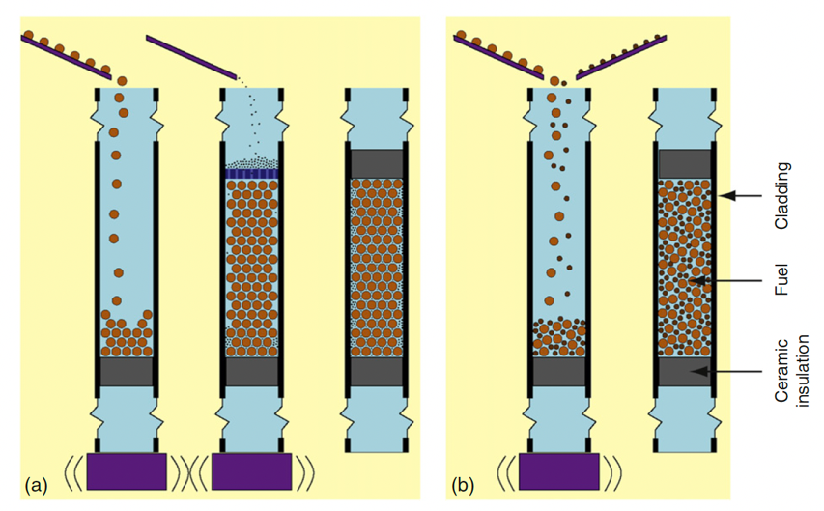
Sphere-Pac Concepts
While the sphere-pac concept is more complex than vipac, it offers additional flexibility
Particle sizes and particle distributions can be included
Spherical particles offer low friction resistance during the filling procedure
Sphere-pac can thus reach up to 90% smear density
Infiltration filling allows for tailoring of small particles to serve specific purposes, such as an oxygen getter, a low reactivity with cladding, etc.

Slide 37
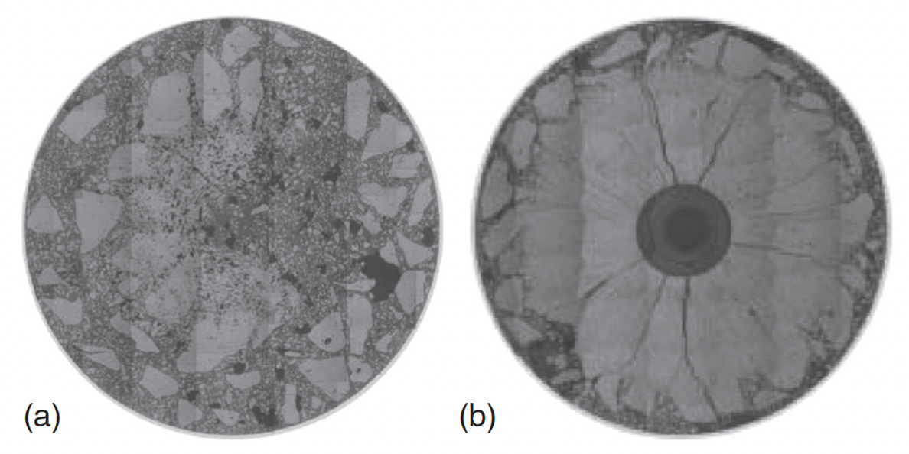
Vipac Irradiations
Japanese irradiations (FUJI Project), with MOX fuel 20% Pu
Vipac fuel after initial sintering test irradiated up to 487 W/cm after 36h
a) Restructuring test with ramping up to 502 W/cm for 36h and b) holding at 502 W/cm for 96h

Slide 38
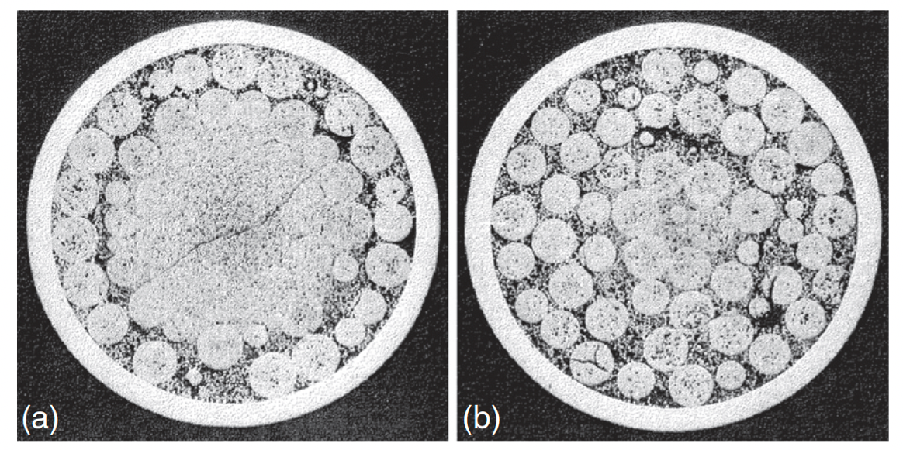
Sphere-Pac Irradiations
Dounreay fast reactor – UPu-C fuels
a) 62 kW/m, 7.3% FIMA, 458C
b) 49 kW/m, 5.7% FIMA, 320C

Slide 39
Overview
Particle fuels are a realistic option for fast reactor systems
Fast reactors allow for efficient burning of actinides
Nominal fast reactor fuel pins are designed for fission gas release, and thus the larger gas release, compared to UO2, is not detrimental
Other fuel bases, other than oxides, can easily be deployed
FCMI is greatly reduced due to the inherent space allowing for swelling of the particles
LWR application is limited

Slide 40
waste glasses

Slide 41
Waste Forms
Fission products (FPs) and minor actinides (MAs) produced during fuel irradiation in the reactor only represent about 5% of the weight of used nuclear fuel, but about 98% of its radioactivity
When fuel is reprocessed, the FPs and MAs end up in concentrated solutions (High Level Waste – HLW) temporarily stored in tanks
Long term (>100 year) storage requires a different path, with initial targets on glass or glass-ceramics to immobilize FPs
The first attempts at the CEA in 1957 targeted crystals of mica-phlogopite: M2Mg6(AlSi3)2O20F4
Twenty years later, borosilicate glass had appeared as the standard choice for the HLW matrix

Slide 42
Glasses
Some liquid phase materials have a high viscosity near the melting point, and such materials tend to crystallize slowly
If a cooling rate is faster than the crystallization rate, the material will rigidify into a “vitreous state”, in which no periodic crystal structure is present
Glass has an absence of order in the distribution of elementary structural units at scales larger than 10–30 Å
Glass is in a metastable state, but is not unstable because the energy barrier to bring it to its more stable crystallized state is generally significant due to the high viscosity
Glass is a non porous, impermeable, isotropic, non cleavable, elastic, solid with a fragile rupture behavior
Glass is a material which transitions continuously and reversibly from liquid to solid state with temperature

Slide 43
Waste Glasses
Vitrification consists of making a new material where the waste components are contained at the atomic scale within the matrix and can only be released by destruction of the network bonds
One major requirement is then that the selected matrix be able to incorporate all of the waste stream components in its structure
By using the flexibility brought about by the disordered and relatively loose structure of a glass, it is possible to design glass compositions able to integrate a very wide range of elements within their structure, and which are tolerant to compositional variations in the waste stream

Slide 44
Behavior of Waste Glasses
The main phenomena that could alter glass containment properties over the long term are heat (for HLW only), radiation damage, and alteration by water
Heat can potentially induce the glass to reach a point beyond the glass transition temperature
However, in nuclear glasses the diffusion is sufficiently slow (high viscosity) to make crystallization incredibly difficult
In the R7T7 glass, a period of several millions of years are required for the three main phases to be completely crystallized at any temperature below 600C

Slide 45
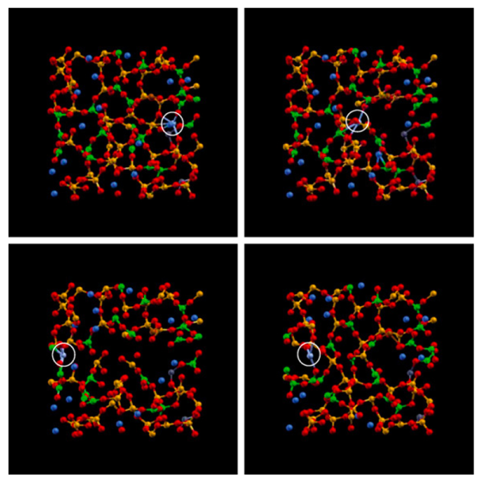
Radiation Damage
Alpha decay is the main cause of radiation damage, where a radioactive nuclide emits an alpha particle (He atom) and a recoil nucleus, generating damage cascades
Due to the effect of alpha decay the glass density decreases slightly, and its mechanical properties improve, especially fracture toughness
MD simulations have been performed that show the capacity of glasses to restore its structure following a cascade event

Slide 46
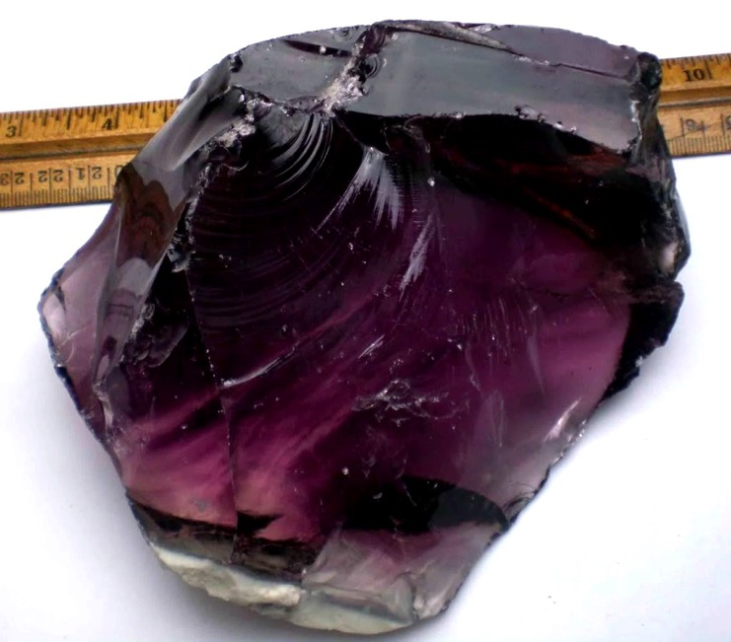
Waste Glass Summary
Vitrification is the world reference solution to the containment of HLW
Glasses can easily incorporate all known fission product species
Glasses will not undergo crystallization due to decay heat
Glasses self-heal irradiation damage
Glasses are reasonably resistant to long-term exposure to sea water

Slide 47
Questions?

